Slide 1
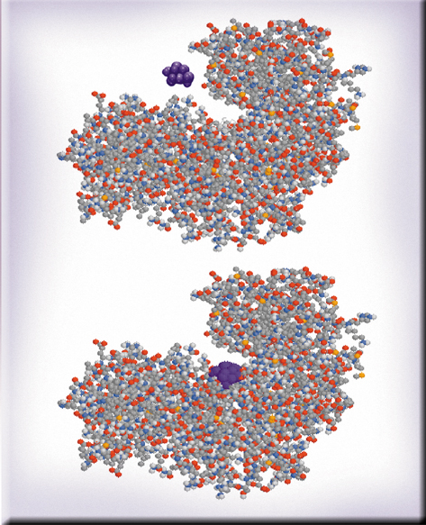

Chemical Kinetics
Chapter 14
Copyright © The McGraw-Hill Companies, Inc. Permission required for reproduction or display.

Slide 2
Chemical Kinetics
Thermodynamics – does a reaction take place?
Kinetics – how fast does a reaction proceed?
Reaction rate is the change in the concentration of a reactant or a product with time (M/s).
A B
Δ[A]
Δ[A] = change in concentration of A over
time period Δt
rate = -
Δt
Δ[B]
Δ[B] = change in concentration of B over
time period Δt
rate =
Δt
Because [A] decreases with time, Δ[A] is negative.

Slide 3
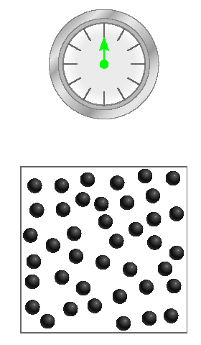
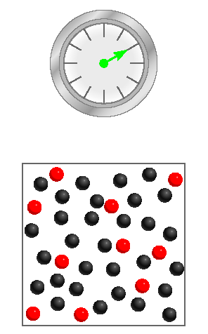
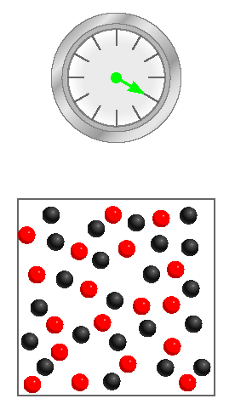
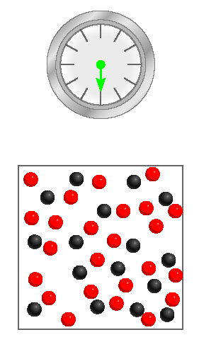
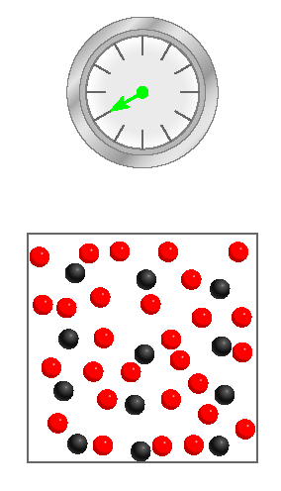
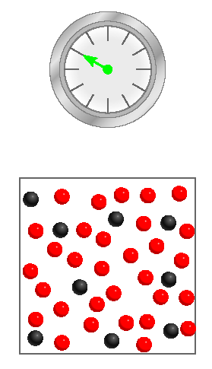
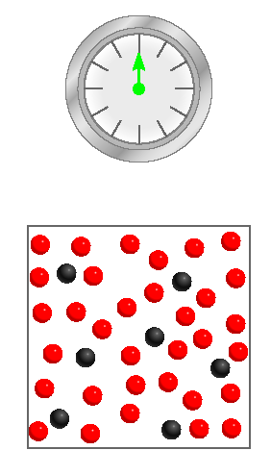
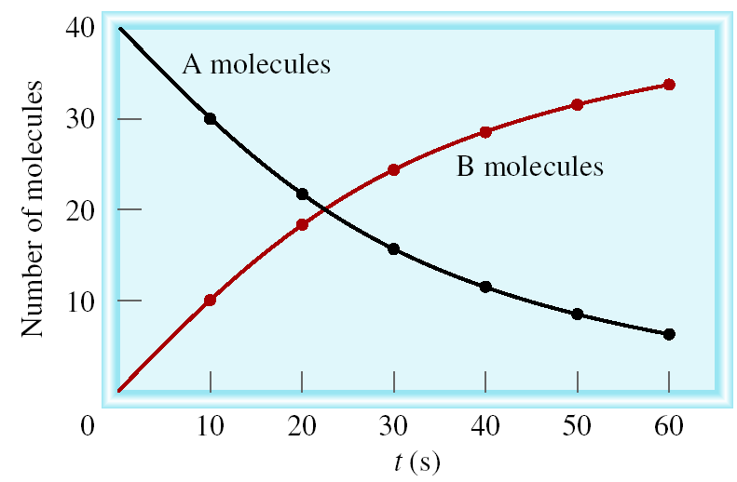
A B
Δ[A]
rate = -
Δt
Δ[B]
rate =
Δt

Slide 4
Reaction Rates and Stoichiometry
2A B
Two moles of A disappear for each mole of B that is formed.
1
Δ[A]
Δ[B]
rate = -
rate =
2
Δt
Δt
aA + bB cC + dD
1
Δ[A]
1
Δ[B]
1
Δ[C]
1
Δ[D]
rate = -
= -
=
=
a
Δt
b
Δt
c
Δt
d
Δt

Slide 5
14.1
Write the rate expressions for the following reactions in terms of the disappearance of the reactants and the appearance of the products:
(a)
(b) 3O₂(g) → 2O₃(g)
(c)

Slide 6
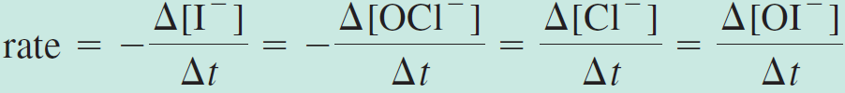
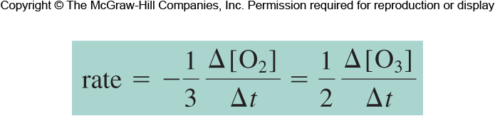
14.1
Strategy To express the rate of the reaction in terms of the change in concentration of a reactant or product with time, we need to use the proper sign (minus or plus) and the reciprocal of the stoichiometric coefficient.
Solution
Because each of the stoichiometric coefficients equals 1,
Here the coefficients are 3 and 2, so

Slide 7
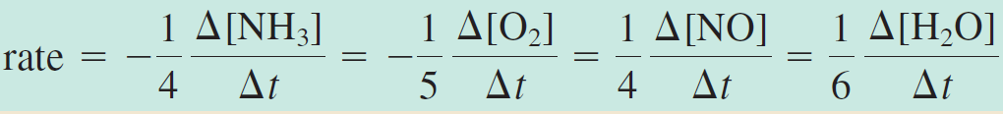
14.1
(c) In this reaction

Slide 8
14.2
Consider the reaction
Suppose that, at a particular moment during the reaction, molecular oxygen is reacting at the rate of 0.024 M/s.
At what rate is N₂O₅ being formed?
At what rate is NO₂ reacting?

Slide 9
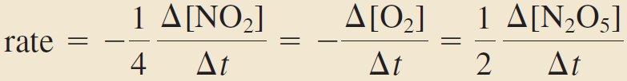
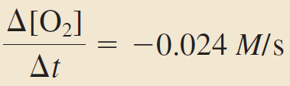
14.2
Strategy To calculate the rate of formation of N₂O₅ and disappearance of NO₂, we need to express the rate of the reaction in terms of the stoichiometric coefficients as in Example 14.1:
We are given
where the minus sign shows that the concentration of O₂ is decreasing with time.

Slide 10
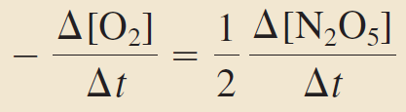
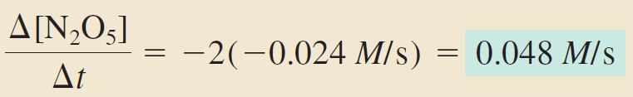
14.2
Solution
From the preceding rate expression we have
Therefore

Slide 11
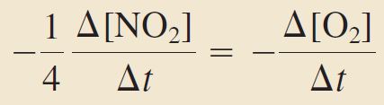
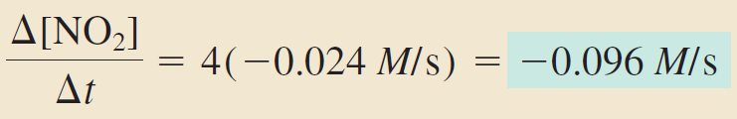
14.2
(b) Here we have
so

Slide 12
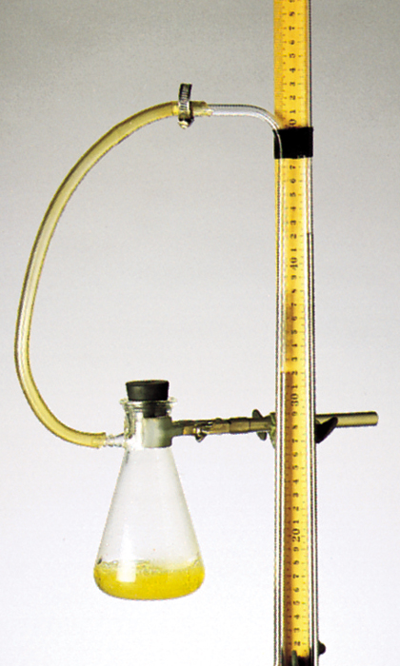
2H₂O₂ (aq) 2H₂O (l) + O₂ (g)
PV = nRT
n
P = RT = [O₂]RT
V
1
[O₂] = P
RT
Δ[O₂]
1
ΔP
rate =
=
Δt
RT
Δt
measure ΔP over time

Slide 13
The Rate Law
The rate law expresses the relationship of the rate of a reaction to the rate constant and the concentrations of the reactants raised to some powers.
aA + bB cC + dD
Rate = k [A]^{x}[B]^{y}
Reaction is xth order in A
Reaction is yth order in B
Reaction is (x +y)th order overall

Slide 14
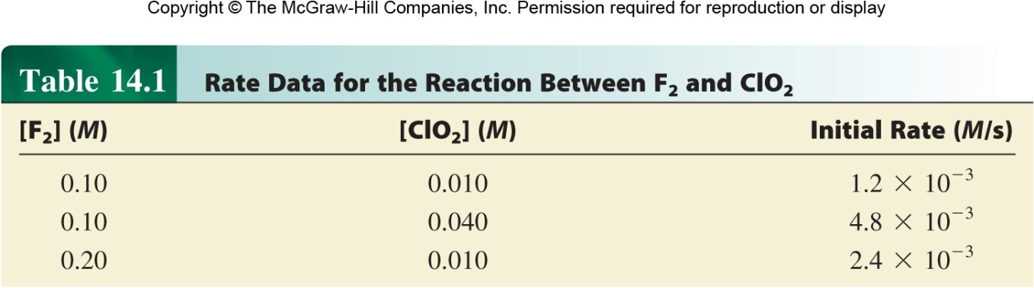
F₂ (g) + 2ClO₂ (g) 2FClO₂ (g)
rate = k [F₂]^{x}[ClO₂]^{y}
Double [F₂] with [ClO₂] constant
Rate doubles
x = 1
rate = k [F₂][ClO₂]
Quadruple [ClO₂] with [F₂] constant
Rate quadruples
y = 1

Slide 15
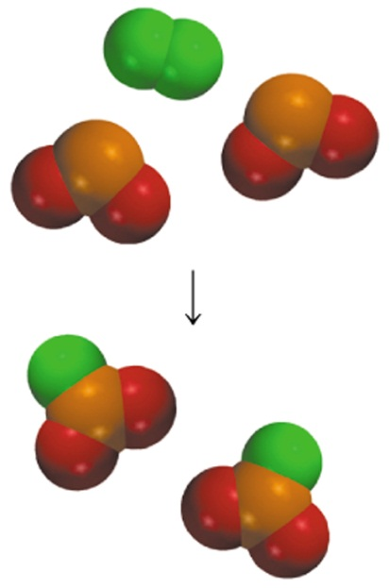
Rate Laws
Rate laws are always determined experimentally.
Reaction order is always defined in terms of reactant (not product) concentrations.
The order of a reactant is not related to the stoichiometric coefficient of the reactant in the balanced chemical equation.
F₂ (g) + 2ClO₂ (g) 2FClO₂ (g)
rate = k [F₂][ClO₂]
1

Slide 16
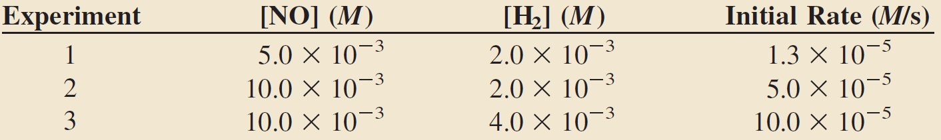
14.3
The reaction of nitric oxide with hydrogen at 1280°C is
From the following data collected at this temperature, determine
(a) the rate law
(b) the rate constant
(c) the rate of the reaction when [NO] = 12.0 × 10⁻³ M and [H₂] = 6.0 × 10 ⁻³ M

Slide 17

14.3
Strategy We are given a set of concentration and reaction rate data and asked to determine the rate law and the rate constant.
We assume that the rate law takes the form
How do we use the data to determine x and y?
Once the orders of the reactants are known, we can calculate k from any set of rate and concentrations.
Finally, the rate law enables us to calculate the rate at any concentrations of NO and H₂.

Slide 18
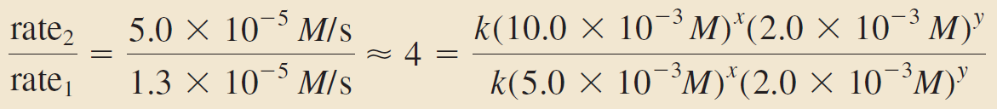
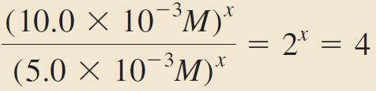
14.3
Solution (a) Experiments 1 and 2 show that when we double the concentration of NO at constant concentration of H₂, the rate quadruples. Taking the ratio of the rates from these two experiments
Therefore,
or x = 2, that is, the reaction is second order in NO.

Slide 19
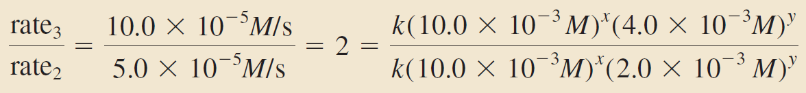
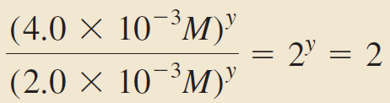

14.3
Experiments 2 and 3 indicate that doubling [H₂] at constant [NO] doubles the rate. Here we write the ratio as
Therefore,
or y = 1, that is, the reaction is first order in H₂. Hence the rate law is given by
which shows that it is a (2 + 1) or third-order reaction overall.

Slide 20
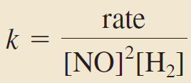
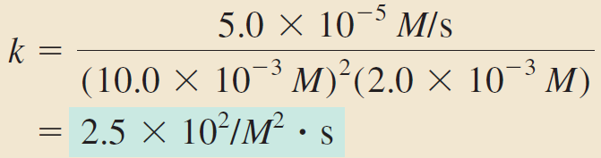
14.3
(b) The rate constant k can be calculated using the data from any one of the experiments. Rearranging the rate law, we get
The data from experiment 2 give us

Slide 21
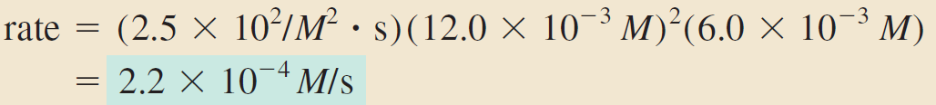
14.3
(c) Using the known rate constant and concentrations of NO and H₂, we write
Comment Note that the reaction is first order in H₂, whereas the stoichiometric coefficient for H₂ in the balanced equation is 2. The order of a reactant is not related to the stoichiometric coefficient of the reactant in the overall balanced equation.

Slide 22

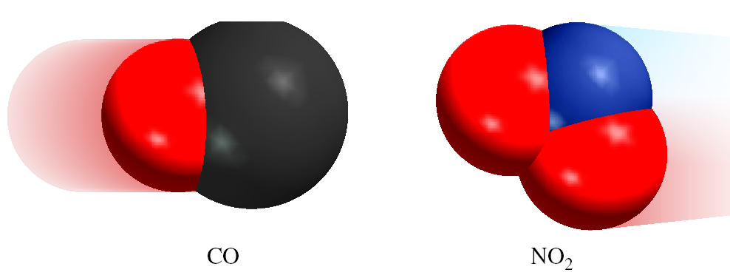
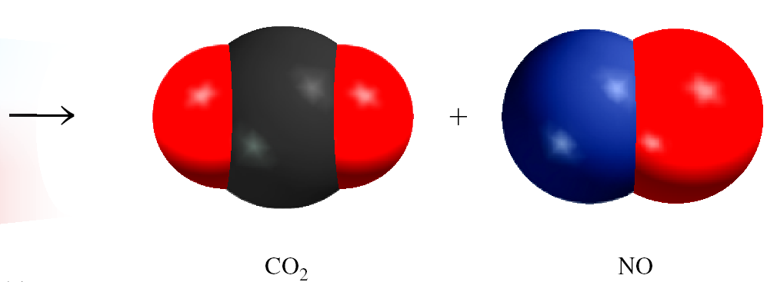
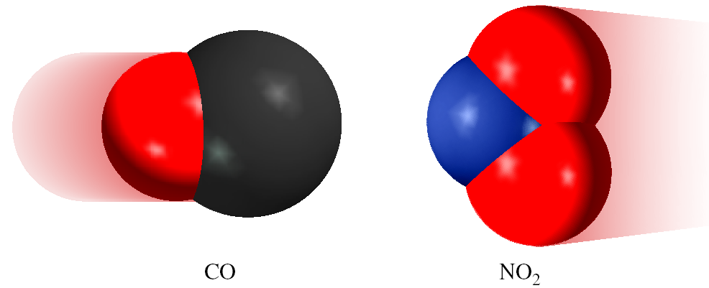
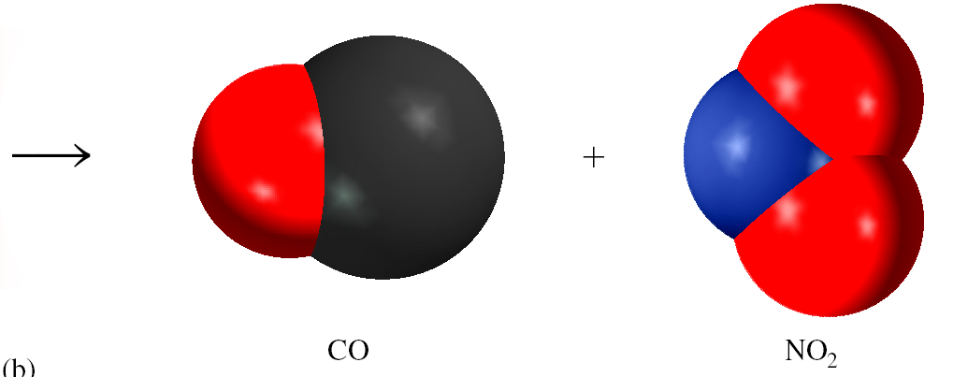
Importance of Molecular Orientation
effective collision
ineffective collision

Slide 23
Reaction Mechanisms
The overall progress of a chemical reaction can be represented at the molecular level by a series of simple elementary steps or elementary reactions.
The sequence of elementary steps that leads to product formation is the reaction mechanism.
2NO (g) + O₂ (g) 2NO₂ (g)
N₂O₂ is detected during the reaction!
Elementary step:
NO + NO N₂O₂
+
Elementary step:
N₂O₂ + O₂ 2NO₂
Overall reaction:
2NO + O₂ 2NO₂

Slide 24

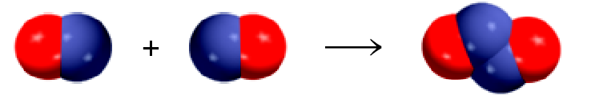

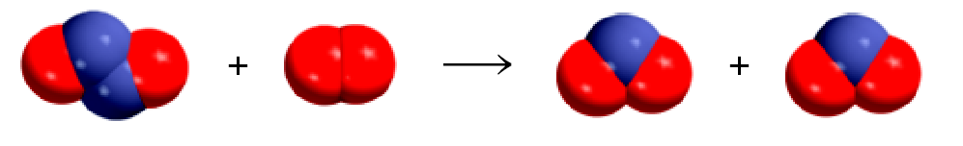
2NO (g) + O₂ (g) 2NO₂ (g)
Mechanism:

Slide 25
Intermediates are species that appear in a reaction mechanism but not in the overall balanced equation.
An intermediate is always formed in an early elementary step and consumed in a later elementary step.
Elementary step:
NO + NO N₂O₂
+
Elementary step:
N₂O₂ + O₂ 2NO₂
Overall reaction:
2NO + O₂ 2NO₂
The molecularity of a reaction is the number of molecules reacting in an elementary step.
Unimolecular reaction – elementary step with 1 molecule
Bimolecular reaction – elementary step with 2 molecules
Termolecular reaction – elementary step with 3 molecules

Slide 26
Rate Laws and Elementary Steps
Unimolecular reaction
A products
rate = k [A]
Bimolecular reaction
A + B products
rate = k [A][B]
Bimolecular reaction
A + A products
rate = k [A]²
Writing plausible reaction mechanisms:
The sum of the elementary steps must give the overall balanced equation for the reaction.
The rate-determining step should predict the same rate law that is determined experimentally.
The rate-determining step is the slowest step in the sequence of steps leading to product formation.

Slide 27
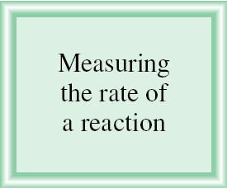
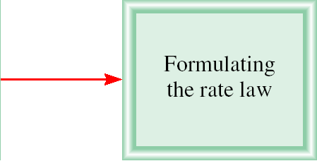
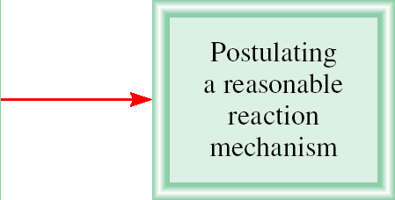
Sequence of Steps in Studying a Reaction Mechanism

Slide 28

14.9
The gas-phase decomposition of nitrous oxide (N₂O) is believed to occur via two elementary steps:
Experimentally the rate law is found to be rate = k[N₂O].
Write the equation for the overall reaction.
Identify the intermediate.
What can you say about the relative rates of steps 1 and 2?

Slide 29
14.9
Strategy
Because the overall reaction can be broken down into elementary steps, knowing the elementary steps would enable us to write the overall reaction.
What are the characteristics of an intermediate? Does it appear in the overall reaction?
What determines which elementary step is rate determining? How does a knowledge of the rate-determining step help us write the rate law of a reaction?

Slide 30


14.9
Solution
Adding the equations for steps 1 and 2 gives the overall reaction
Because the O atom is produced in the first elementary step and it does not appear in the overall balanced equation, it is an intermediate.
If we assume that step 1 is the rate-determining step (that is, if k₂ >> k₁), then the rate of the overall reaction is given by
and k = k₁.

Slide 31
14.9
Check Step 1 must be the rate-determining step because the rate law written from this step matches the experimentally determined rate law, that is, rate = k[N₂O].

